Slide 1
System programing HW2
TA: Curtis Lee

Slide 2
Goal
We are going to synchronize the files and directories under local repository to server side
Don’t worry, we have built up the client and server, you only have to pay attention to the process of synchronization.

Slide 3
Socket
UNIX Network Communicate API
It's accessed as file descriptor, so you can communicate using read/write, or using socket's own recv/send API.
recv_message(), send_message() in hw2

Slide 4
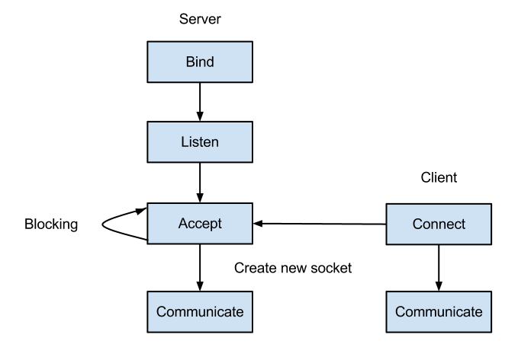
Socket Connection

Slide 5
port_register
daemon provide by TA which provide port management service
TA would run this for you on linux1~linux20
If you want to test connection at localhost, you should run port_register first
$ ./port_register &

Slide 6
How to run server and client?
Modify server config file named server.cfg
Path: the path of server directory, named “sdir” in example
Account_path: the path of account file, which has account info
Server.cfg
account

Slide 7

How to run server and client?
Modify client config file named client.cfg
Name: your account name, student ID in work station
Server: localhost
User
Passwd
Path: the path of client local repository, named “cdir” in example

Slide 8
How to run server and client?
Enter directory “src”, and type “make” to compile source code.
Enter directory “bin”, execute process “port_register”. If you works on work station, you don’t have to do this, we have run it on work station.

Slide 9
How to run server and client?
Execute process “csiebox_server” with path of server.cfg.
Execute process “csiebox_client” with path of client.cfg.
After finished the steps above, you run up the server and client.

Slide 10
Then?
You connect client to server and log in after you run up the server and client.
Then you start to synchronize files and directories under local repository to server.
We designed five types of header for synchronization.

Slide 11
Five types of complete header
csiebox_protocol_login
csiebox_protocol_meta
csiebox_protocol_file
csiebox_protocol_hardlink
csiebox_protocol_rm
Each complete header has a common header
csiebox_protocol_header

Slide 12
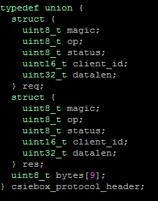
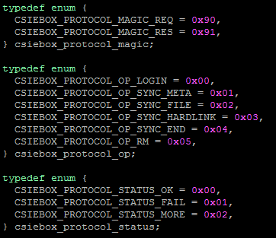
csiebox_protocol_header
magic
op
status
client_id
datalen

Slide 13
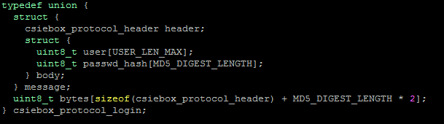
csiebox_protocol_login

Slide 14
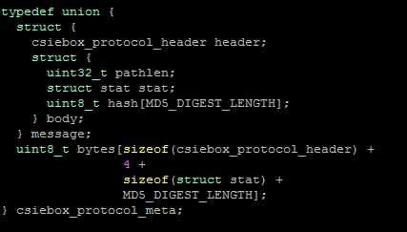
csiebox_protocol_meta
Header used to send meta data of file or directory.
Followed by a path of that file or directory under local repository.

Slide 15
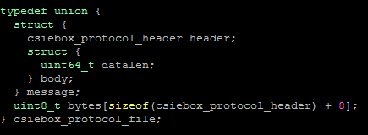
csiebox_protocol_file
Header used to send data of file, followed by file data.

Slide 16
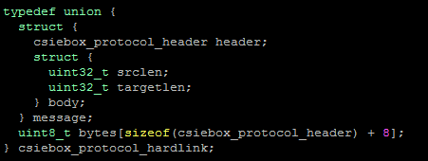
csiebox_protocol_hardlink
Header used to sync hard link
Followed by source path and target path under local repository

Slide 17
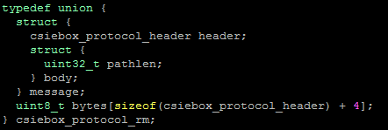
csiebox_protocol_rm
Header used to delete file or directory on server side
Followed by the path of deleted file or directory under local repository

Slide 18
Requirements
Sync existed files and directories under client local repository to server. It includes traversing directory tree on client’s side, and transmit the file and directories to server.
To determine you actually do the directory traversal, you have to output the longest path on local repository, starting from service root directory, to file longestPath.txt in service root directory
Ex. cdir/abcdefghijk is longer than cdir/a/b/c . Therefore, abcdefghijk is outputted.

Slide 19
Requirement
To keep the same content on both side, we use inotify API, which is used to monitor file system events. (Example program of using inotify API is available in the provided package.) You can get more info of inotify by linux man page.
Symbolic link
Hard link
The structure of server user directory should be the same as the structure of local repository.

Slide 20
Grading
Total 8 points.
5 points for synchronizing existed files and directories between client and server.
(1 point) traverse directory tree: output the longest path on local repository to file longestPath.txt in service root directory.
(1 point) sync regular file
(1 point) sync directory
(1 point) sync symbolic link
(1 point) sync hard link

Slide 21
Grading
The following requirements need to use inotify API.
2 points for synchronizing the files, including regular files, directories, and links, newly created or modified under local repository to server. Finishing each of them earns 0.5 point.
1 point for synchronizing the deleted files and empty directories under local repository to server.

Slide 22
Due day
Tuesday October 29, 2013 23:59
Renamed directory “sp_hw2b02XXXXXX” with your student ID, and compress it. Upload it to CEIBA.
5% of your credits will be deducted for every single day delay.
There is absolutely NO tolerance for plagiarism. Zero points for plagiarism.

Slide 23
Contact
Email: box0922480107@gmail.com
Ptt2 : SysProgram, TA’s account: f771213

